Slide 1


TIGER EYES
Team member : Chong Sun & Bo Li
Class : CPSC 681
Tiger Eyes
*
1

Slide 2
Outline
Background
Intro
Video
Demo
Technique
Acknowledge
Thank you
Tiger Eyes
*
2

Slide 3
BACKGROUND
Augmented Reality (AR) was first demonstrated in the 1960
recently have technologies emerged that can be used to easily deploy AR applications to many users.
Camera-equipped cell phones with significant processing power and graphics abilities provide an inexpensive and versatile platform for AR applications.
Tiger Eyes
*
3

Slide 4






INTR DUCE
See the buildings information through camera;
Upload new location to database;
Record your car location and find it;
Scan QRCode and get more information from database;
Synchronous database from extra to local.
*
4

Slide 5

Video
Tiger Eyes
*
8

Slide 6

Demo
Tiger Eyes
*
8

Slide 7
Technique
Augmented Reality: “ArKit”
Record car location: userDefault;
QRCode;
Why not Google Api;
Synchronize database.
Tiger Eyes
*
8

Slide 8
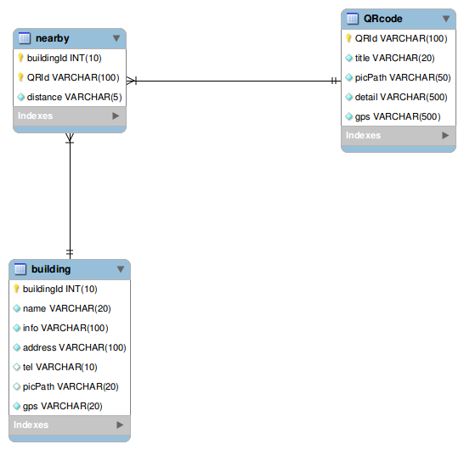
Database Schema
Tiger Eyes
*
7

Slide 9
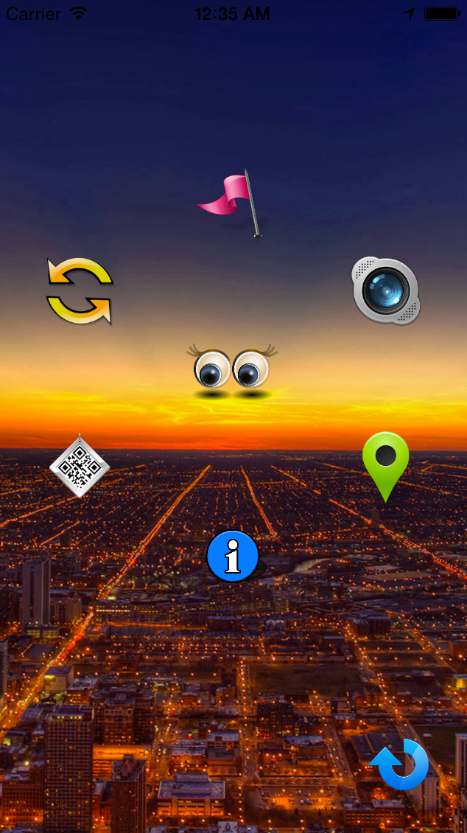
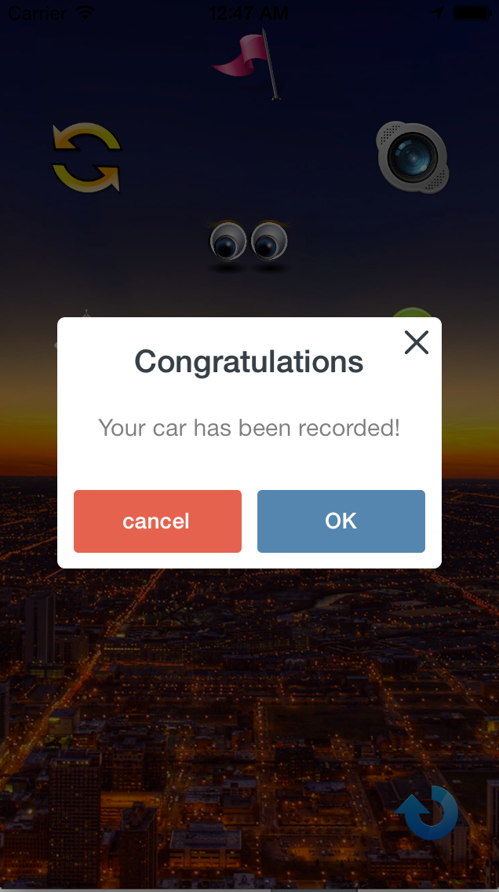
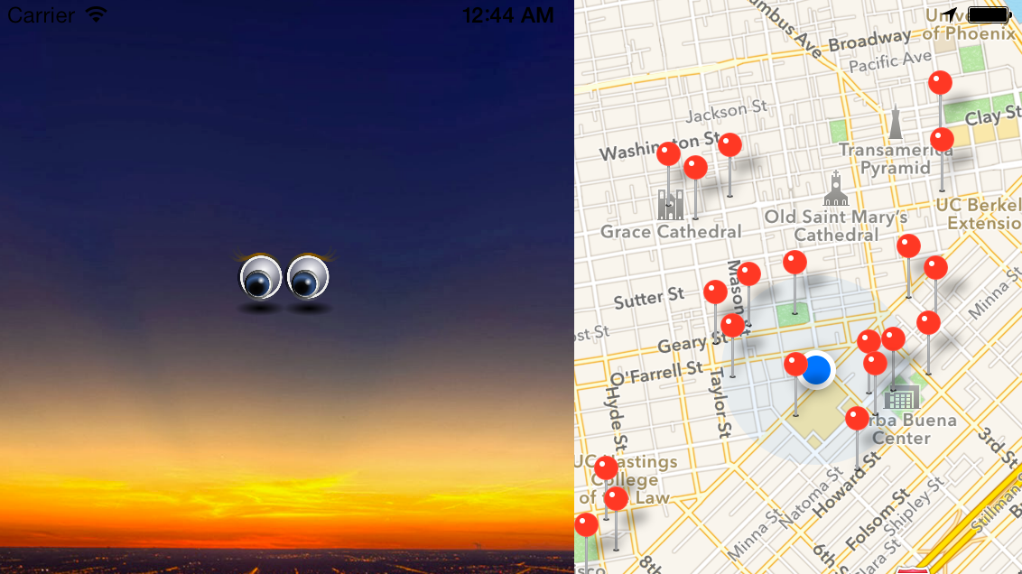
User Experience
Menu
Rotate
Pop-up Box
Tiger Eyes
*
8

Slide 10
ACKNOWLEDGE
1.Thanks to Dr. Pargas and Punit’s help!
2. Thanks to Github. It is so great for group job.
3. Thanks to wimagguc for his great design of customized IOS7 alert view.
4. Thanks to stack overflow. It is always a good place to address our problems.
Tiger Eyes
*
10

Slide 11
Any question？
Contact info: email:hello2pig@gmail.com
Tiger Eyes
*
11

Slide 12
Thank you!
Tiger Eyes
*
12

